Slide 1
Bank of Chain On Aptos

Slide 2

What is BoC?
“Zero Risk” Yield Aggregator
Help Web2 users easily access Web3 and gain profit
Launched on Ethereum on 2022

Slide 3
Yield aggregator
BoC help users allocate their funds deposited into third-party yield generating DeFi protocols, aggregating yield from different sources.
Market-making fees
Interest from over-collateralized lending
Governance token rewards, rewards from staking, among others.
Sources of yield
Only Pyth oracles.
Only billion-dollar fully collateral stablecoins.
Only fully audited protocols with high TVL and good track records.
Near "risk-free"

Slide 4
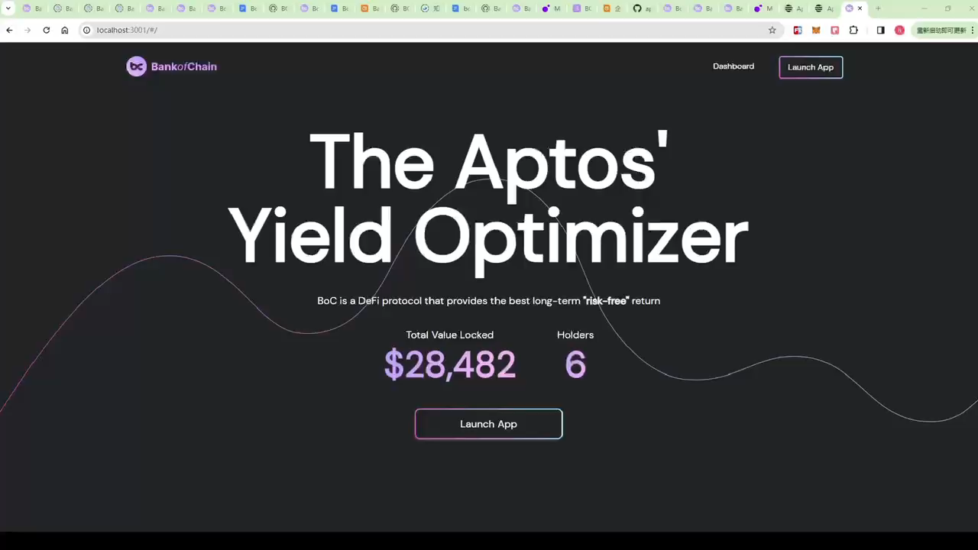

Slide 5

Why BoC?
User-Friendly & Massive Adoption
Help Web2 users easily access Web3 and gain profit

Slide 6







Social Login
User-Friendly & Massive Adoption
Leveraging the native keyless feature of the APTOS blockchain, users can log in using their Google accounts.
Help Web2 users easily access Web3 and gain profit
Gas-Free Transactions
Utilizing the blockchain's native GAS sponsorship feature, the project side pays the GAS fees on behalf of the users.
On-Ramp
Integrate MoonPay to support fiat top-ups for APT and USDC tokens on the APTOS blockchain.
Intent Recognition
Enter your ideas via voice or text, and AI will recognize the intent, with manual confirmation required only.

Slide 7
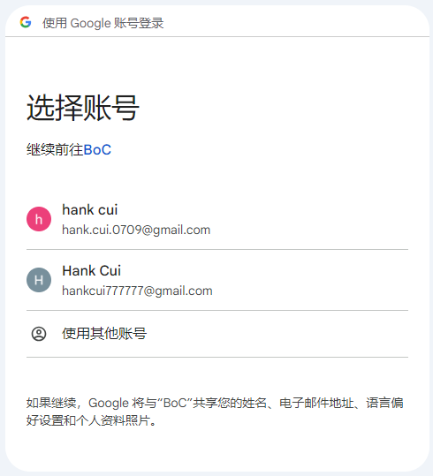
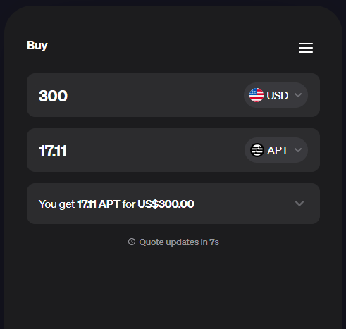
Ease of Use
Social Login
On-Ramp
Leveraging the native keyless feature of the APTOS blockchain, users can log in using their Google accounts.
Integrate MoonPay to support fiat top-ups for APT and USDC tokens on the APTOS blockchain.

Slide 8
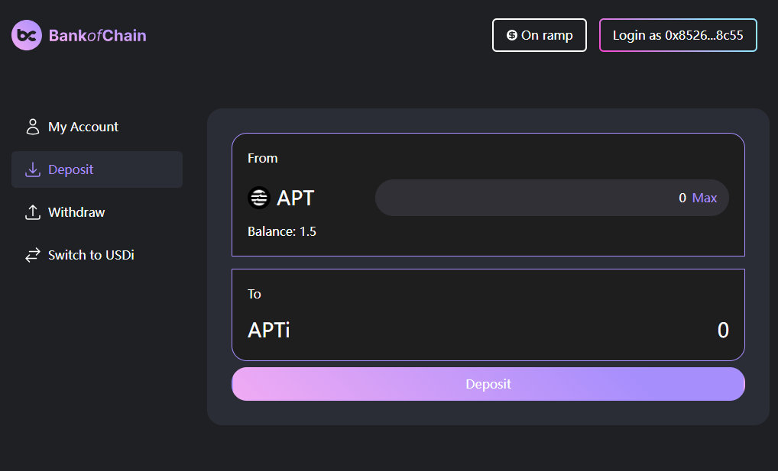
Ease of Use
Gas-Free Transactions
Utilizing the blockchain's native GAS sponsorship feature, the project side pays the GAS fees on behalf of the users.
Intent Recognition
Enter your ideas via voice or text, and AI will recognize the intent, with manual confirmation required only.
User-friendly
Only two operations: deposit and withdrawal（No Lock Duration）

Slide 9






Safe
Risk Management
Security by Design
Security Audit
Impose funding limits on each protocol to disperse capital and spread risk. Avoid obtaining returns by providing risk-bearing services, such as options.
Deployed on the APTOS blockchain, which is known for its high security. The integrated protocols are all top-ranked, audited, and of high security standards.
All smart contracts will be audited by reputable third-party audit firms based overseas.

Slide 10
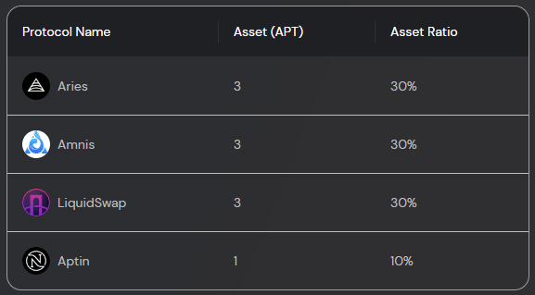
Safe：Risk Management
Funding Allocation Rules
Allocate funds preferentially to high-yield liquidity pools.
Limit pool investments to 30% of total assets.
Ensure pool investments do not exceed 50% of locked positions.
Aggregate investments in a protocol's pools should cap at 40% of total assets.
egularly assess earnings and rebalance funds for net benefit.

Slide 11





Integrate high-quality DeFi protocols
Efficiency
Integrate DeFi protocols with a proven track record of good, safe, and high-yield performance.
Earn compound interest via Automatically reinvest
Leveraging the low GAS characteristics of the Aptos blockchain, enable automated and swift harvesting and reinvestment.
Automated and rapid portfolio rebalancing
The Keeper algorithm predicts the weight of rewards distribution for the next period, prioritizing allocation to liquidity pools with higher yields.
Continuous and rapid updates
Continuously monitor new projects, promptly integrate qualified new protocols, ensuring the platform's sustained and robust high returns.

Slide 12

Add-on Features

Slide 13
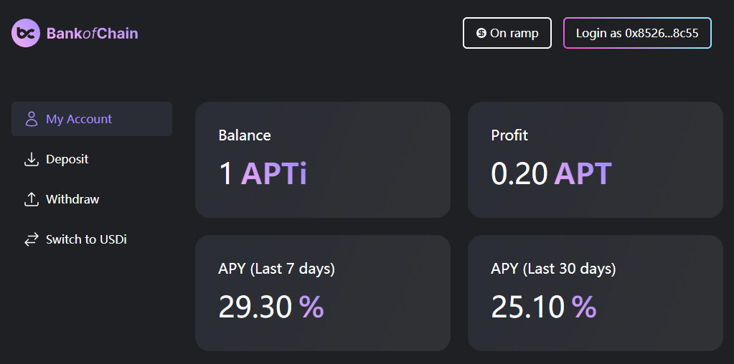
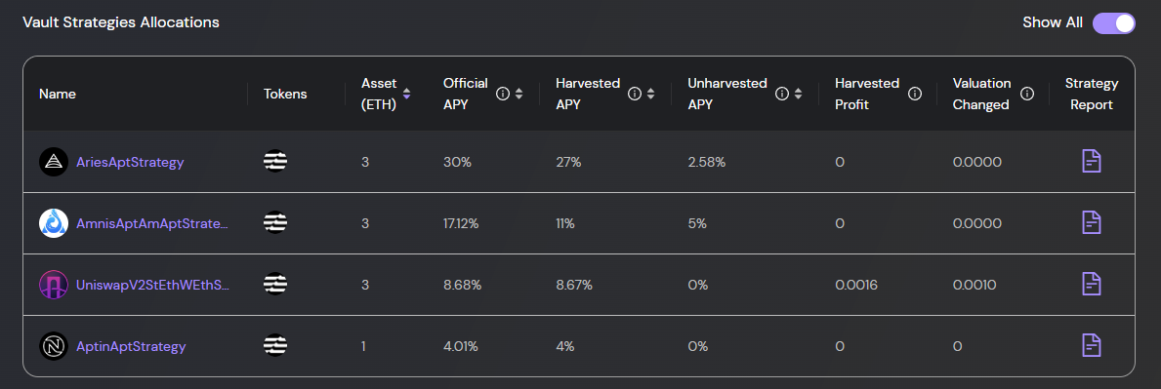
Detailed Info Dashboard
Users' earnings are transparent & visible
Protocol's earnings are transparent & visible

Slide 14
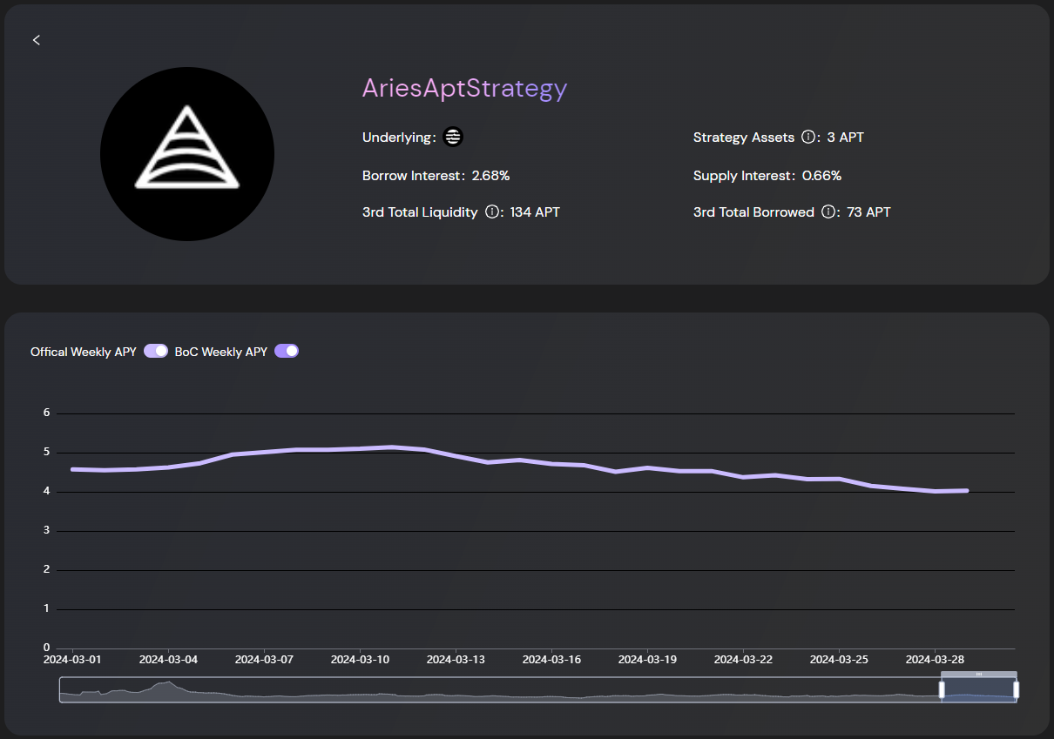
Comprehensive Underlying Strategy Information

Slide 15

More

Slide 16
01
Offering Multiple Vault Options
The USDi Vault offers principal-protected financial earnings based on stablecoins.
The APTi Vault provides not only financial returns based on the APT token but also the potential for token value appreciation.
02
Backtesting Mechanism
All strategies are subject to validation through a backtesting system before they go live.
03
Incorporated Oracle
Utilize Pyth as a price oracle.

Slide 17
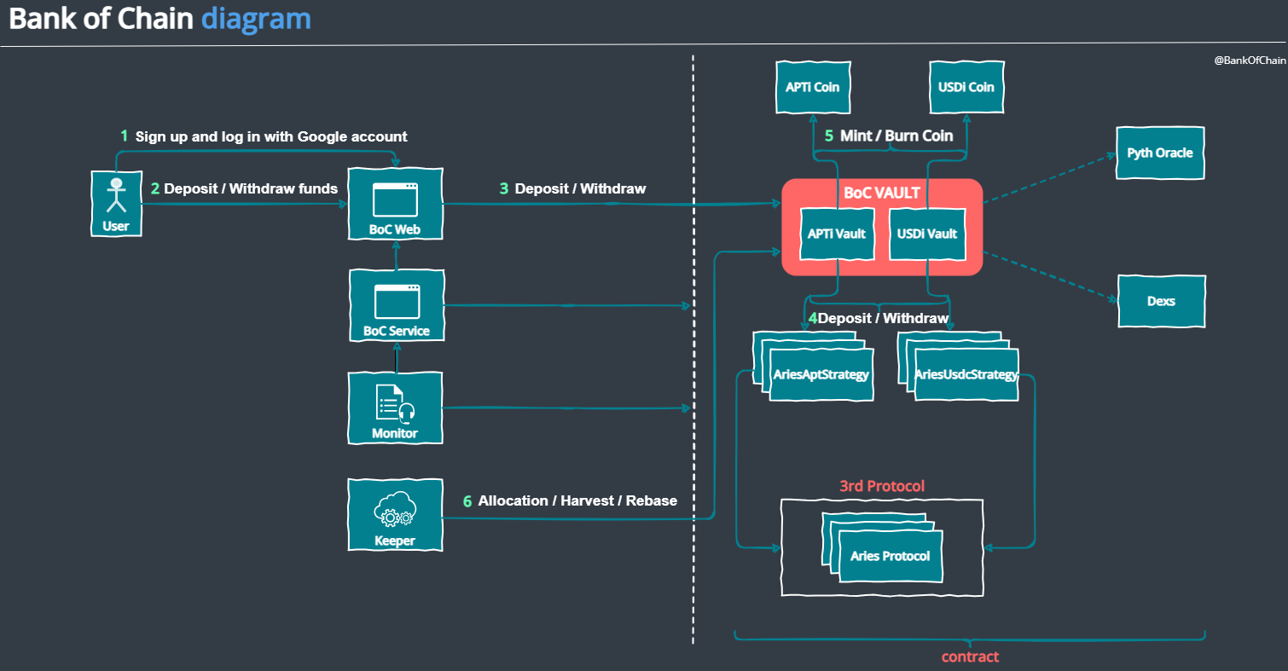

Slide 18
Thanks

